Slide 1
PROBLEM-SOLVING AND C-PROGRAMMING​ END-SEM PROJECT
IMAGE TRESHOLDING

Slide 2
TOPIC-Thresholding Of A IMAGE
GROUP-12
M.NILAVARASN | CB.EN.U4AIE22139
P.GUNA PUSALAVARDHAN | CB.EN.U4AIE22145
P.SAI SANTHAN | CB.EN.U4AIE22146
KJ.MADHAVAN NARAYANAN | CB.EN.U4AIE22135

Slide 3
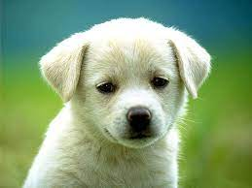
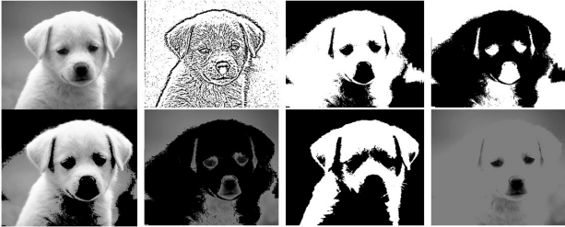
Aim Of This Project…
The aim of this Project is to do Thresholding of any Image,a Greyscale or a RGB-image ,in C-program with the help of only
Stdio.h
Stdlib.h
Libraries in C , and we will not be using any other Libraries for Image
Processing.

Slide 4
Table of contents
01
02
03
04
Introduction
Methadology
Source-Code
Result
05
Conclusion

Slide 5
INTRODUCTION

Slide 6
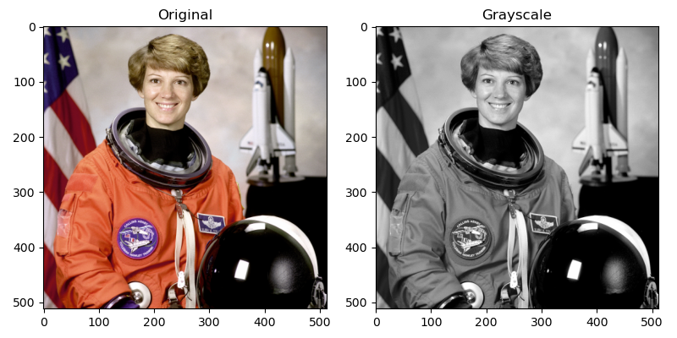
GREY-SCALE IMAGE
We know that each pixel’s in an image has an certain value, the pixel’s will have value and the value ranges from ‘0’-‘255’,and 0-black,255-white.The pixel’s value in an image can be anything in the above mentioned range(0-255),for instance if the pixel value is 50 it is grey in colour,but an darkish grey.Due to this range is why we can see an image in grey-shades.The greyscale image has only one channel because the pixel’s will determine only the brightness of the image (if near ‘255’ brighter and if near ‘0’ then darker),unlike an RGB image discussed in the below section.

Slide 7
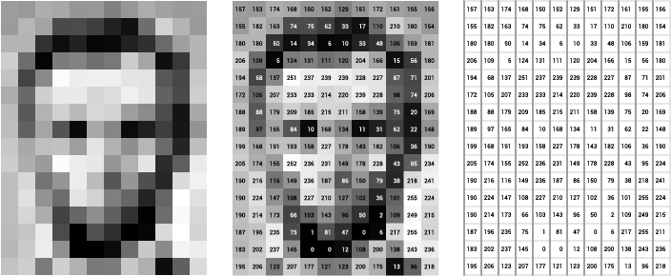
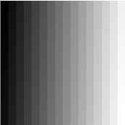
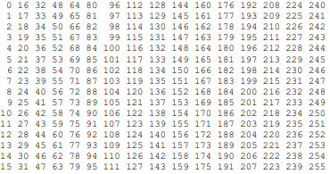
Image and it’s Matrix.
A digital grayscale image is presented in the computer by a pixel of the matrix. Each pixel of such an image is presented by one matrix element – an integer from the set. The numeric values in pixel presentation are uniformly changed from zero (black pixels) to 255 (white pixels), {0,1,2,...255}.

Slide 8
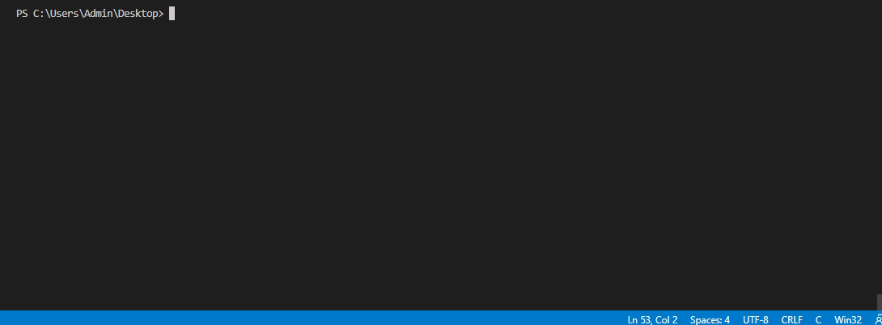
Reading the Pixel Value of the Image in ‘C’.

Slide 9
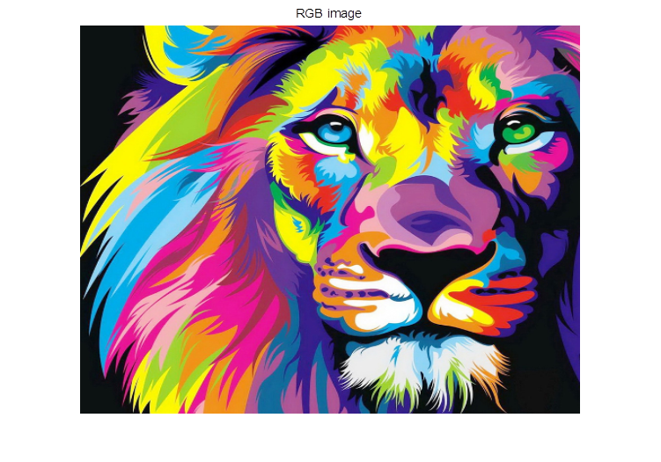
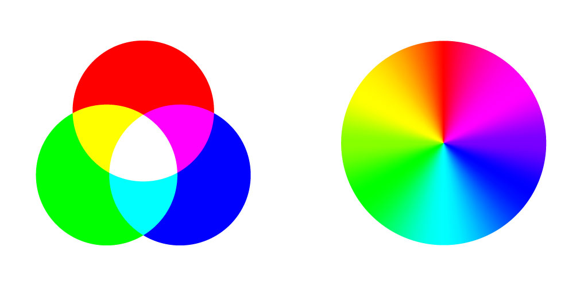
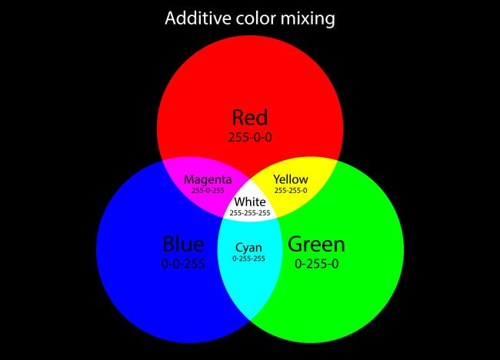
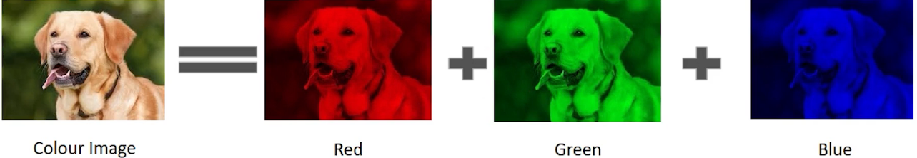
RGB-IMAGE
An RGB image is a digital image format that uses a combination of red, green, and blue light to create a full range of colors. Each pixel is represented by three values that correspond to the intensity of red, green, and blue light at that location. Any color image , which Is a mixture of any color is non-other then but a combination of the three colors(RGB).

Slide 10
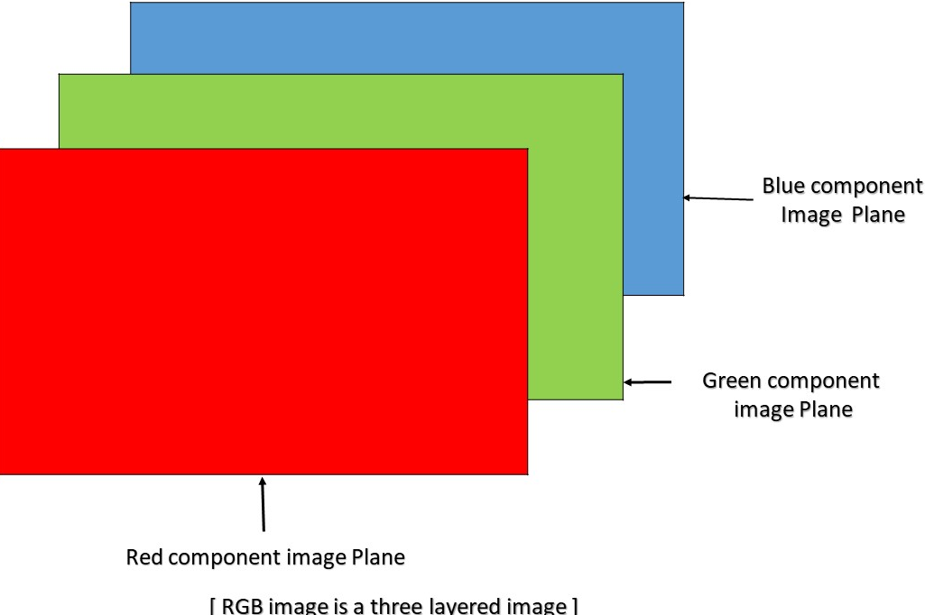
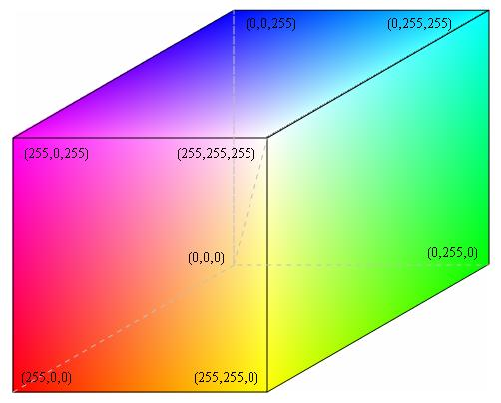
RGB-Image and its Matrix.
RGB image is a three-dimensional matrix. with three layers of a two-dimensional matrix. suppose x and y are the coordinates of any element in a two-dimensional matrix, then the coordinates of the red layer refer to (x,y,0), the green layer coordinates refers to the (x,y,1), and the blue layer coordinates refers to (x,y,2). blue layer refers to the two-dimensional array,
therefore the blue, green, and red layers
each separately refers to a two-dimensional
matrix and when combined is a
three-dimensional matrix, the range of the values Is
0-255, in unit 8 (unsigned 8-bit integer) it Is nothing but the
the intensity of the color.

Slide 11
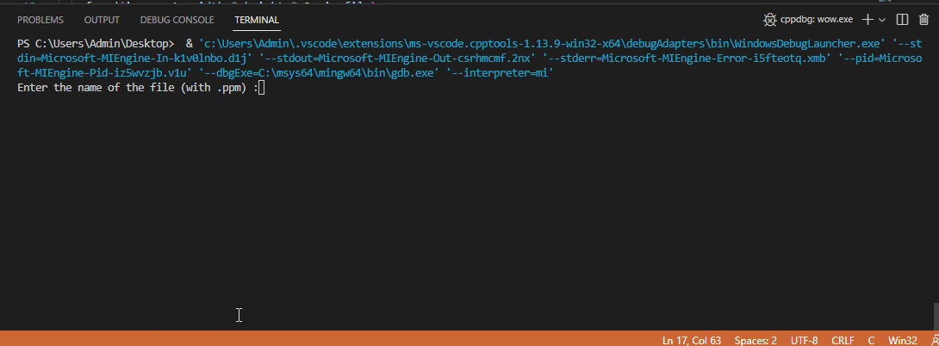
Reading the Pixel Value of RGB Image in ‘C’.
The unsigned-int16, uint16-class RGB image, each color component is represented as a 16-bit unsigned integer with a range of values between 0 and 65535, where 0 represents the absence of the color, and 65535 represents the maximum intensity of the color.
But we will use unsigned char, where the range of intensity of the
color is 0 to 255,we will use
unsigned char.

Slide 12
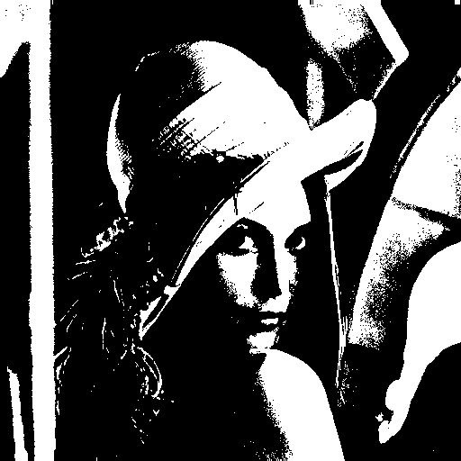
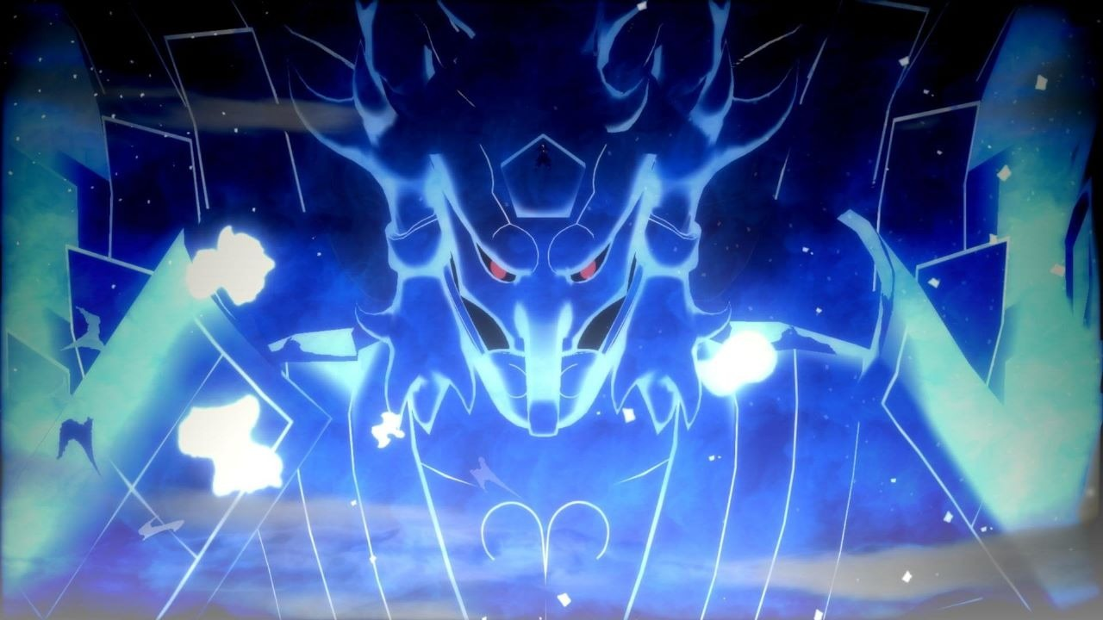

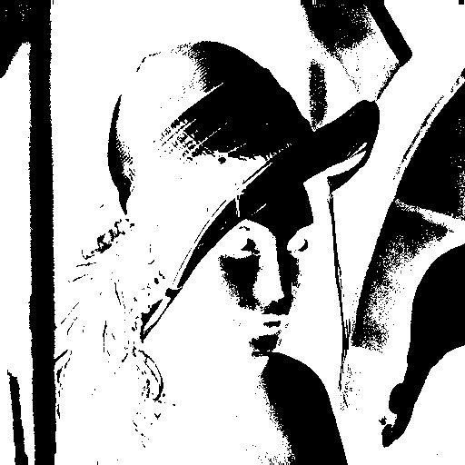
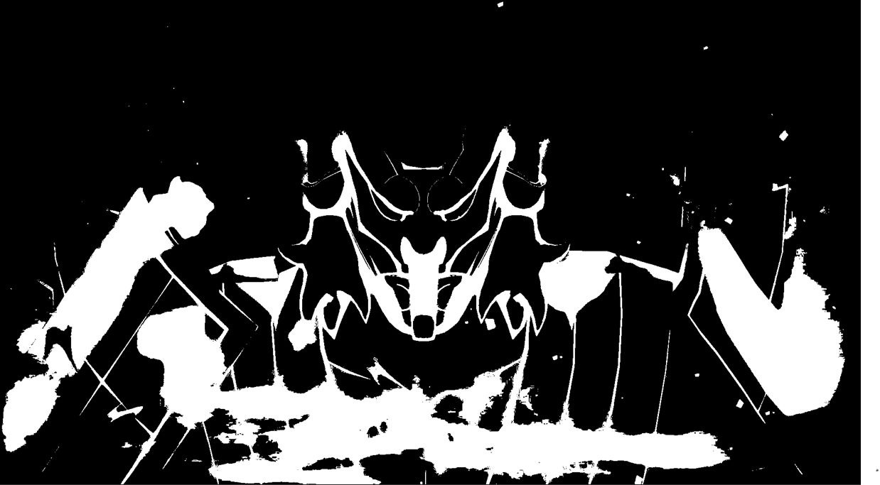
Black & White Image.
Black an white image is a special case of a greyscale image,where each pixel in an image has a value eithier ‘0’(black) or ‘255’(white) only, therefore the resulting image will have only two shades of color black and white ,in another way to say black and white image is an binary image.

Slide 13
Meaning Of This TOPIC.
Thresholding a Grey-Scale Image.
Generally, Image thresholding is a process of converting a greyscale image to a binary image(if each pixel in a image has it’s intensity value either ‘255’ or ‘0’ ),a black and white image is considered as a binary image.from the above section it is clear that each pixel in a greyscale image has intensity value in range 0-255,which pixel’s in a image should be assigned to the value ‘0’ or ‘255’ is decided by the treshold value .The treshold value are user defined,if an pixel value is greater than the treshold value assigned by the user then we will assign it’s value as ‘0’(black) and the other pixels which don’t satisfy the above condition will be assigned value as ‘255’(white) and vice-versa(the values ‘0’ and ‘255’ can be assigned in the opposite way also).

Slide 14
Different Cases In Tresholding a IMAGE
CASE-1
CASE-2
CASE-3
Make the values greater than the threshold brighter, ‘255’.
Make the values lesser than the threshold brighter,‘255’.
Make the values greater than the threshold darker, ‘0’.
CASE-4
CASE-5
CASE-6
Make the values lesser than the threshold darker
Make the values greater than the threshold value brighter and lesser darker
Make the values greater than the threshold value darker and lesser brighter

Slide 15
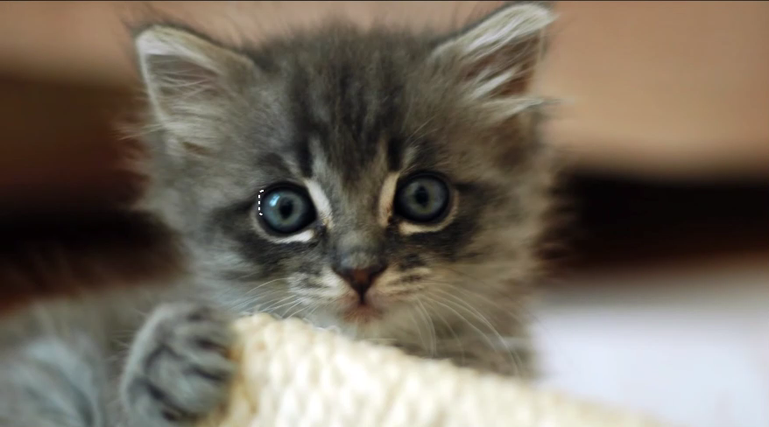
Thresholding an RGB-Image.
We know that an RGB image is represented by a color combination of red, green, and blue intensity
So a pixel in an RGB image is a combination of the intensity of the Three colors, basically, an RGB image has Three channels. The combination of the intensity result’s in different colors. The difference between grayscale and RGB images is that grayscale images represent a single intensity value for each pixel, while RGB images represent three color components (red, green, and blue) for each pixel, allowing for the representation of a wide range of colors.

Slide 16
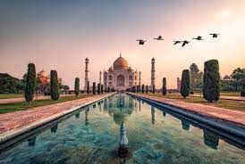
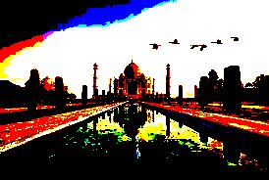
Due to three channels in an RGB image, therefore thresholding of an RGB image cannot be done directly, because each color has different intensities and from the meaning of thresholding of an image, the intensity lesser than or greater than according to condition is set to ‘0’ or ‘255’, which indeed will lead to the creation of a new image, of some-kind, Example of it is below.

Slide 17
Then how Thresholding is Done in a RGB Image.
RGB image which has three channels red, green, and blue is converted to a single channel of single intensity that is converted to a Greyscale image. Then the same logic for thresholding of a greyscale image is applied, we are converting since RGB has different channels.
RGB TO GREY:
By summing the intensities of the three colors of a specified pixel and taking their average by dividing them by three and same process is done to all the pixels.
Y = 0.2989 * R + 0.5870 * G + 0.1140 * B, R is the intensity of red, B is the intensity of BLUE, G is the intensity of green, where Y is the pixel value we get after substituting the value of the red green and blue components.To convert an RGB image to greyscale in C, you can loop through each pixel in the image, extract its R, G, and B components, and use the formula above to calculate the corresponding Y value. Then, you can set all three RGB components of the pixel to the same Y value, effectively converting it to greyscale

Slide 18
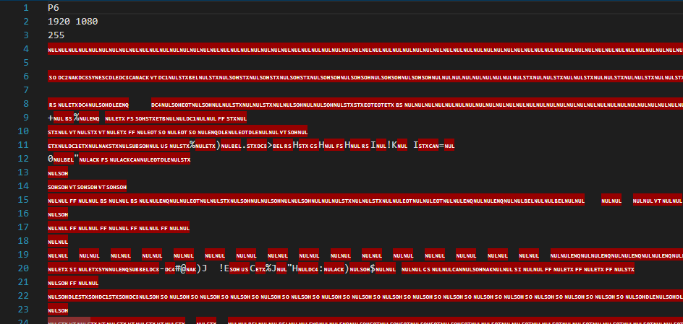
Image Formats.
PPM Format.
BMP.
PPM.
JPEG.
PNG.
We will use these format’s in our Project.
PPM (Portable Pixmap Format) is a basic image that stores image data as ASCII text or binary data and includes information about the image dimensions and color depth, it stores in a three-dimensional matrix(3-D).
BMP Format.
Bmp stands for Bit-Map image, It stores digital images in a straightforward way, using a pixel-based format that is easy for computers to read and process, note it stores an image as two dimensional-matrix(2-D).

Slide 19
JPEG And PNG
We will not be using JPEG and PNG type of formats in our project since, the jpeg and png type of image formats are usually in compressed form due to which some amount of data of the pixels are compressed and lost, which is why it is not possible to access this type of image format’s in c, with the help of regular libraries. And these formats are driven by the BMP format, which is an uncompressed format, and due to the availability of all the data, in simple words no loss of data of the pixels, similarly even in PPM format.
But can be solved with other libraries
Like:
BMP, PPM, no loss of data, preferred in this project.
JPEG and PNG loss of data, some amount of data is lost, not used in this project.
libjpeg,libpeg, and std image.

Slide 20
METHADOLOGY

Slide 21
Basic Algorithm for images.
The integer matrix is manipulated according to the condition specified, for the integer elements on a matrix.
Input image from the user, using file handling method.
Convert to an integer Matrix each integer representing each pixel in an image, and find height and width.
Using height and width as ‘i’ and ‘j’ for loop is run, and the same is applied for each and every element on a matrix, which is applied for each and every pixel in an image.
This modified integer matrix is saved in another defined output image, using the file handling methods.

Slide 22
Algorithm For PPM Format
we have used PPM6 and PPM3 types of images For thresholding of images.
Intialize the required variables,
Create a pointer of data type FILE, and use fopen function to store address, of file in pointer in the defined pointer.
Find height and width of the image using, fscanf function .
Use maloc function, to create memory, so that data can be stored dynamically.
Convert RGB image to greyscale-image if needed.
Do necessary operation on image according to the question, by considering each pixel
Use fread to store the file or image in the defined pointer.
Close the file , using fclose
Create another folder using “write”, to store the processed image,using fwrite function.

Slide 23
SOURCE-CODE & LINE-WISE EXPLANATION.

Slide 24
For PPM Image Format. For case-1:Make the values greater than the threshold brighter, ‘255’.
#include <stdio.h>
#include <stdlib.h>
int main() {
// Declare image variables
int width, height, max_color;
unsigned char *image;
int threshold;
char str[100];
printf("Enter the name of the file (with .ppm) :");
gets(str);

Slide 25
// Read image from file
FILE *in_file = fopen(str, "rb");
fscanf(in_file, "P6\n%d %d\n%d\n", &width, &height, &max_color);
image = (unsigned char *) malloc(width * height * 3);
fread(image, 1, width * height * 3, in_file);
fclose(in_file);
// Convert to Grayscale
for (int i = 0; i < width * height * 3; i += 3)
{
int avg = (0.299*image[i] + 0.587*image[i + 1] + 0.114*image[i + 2]);
image[i] = avg;
image[i + 1] = avg;
image[i + 2] = avg;
}
// Ask user for threshold value
printf("Enter the threshold value: ");
scanf("%d", &threshold);

Slide 26
// Threshold the grayscale image
for (int i = 0; i < width * height; i++) {
if (image[i] < threshold) {
image[i] =255;
} else {
image[i] = image[i];
}
}
// Write Thresholded image to file
FILE *out_file = fopen("output_withThreshold.ppm", "wb");
fprintf(out_file, "P6\n%d %d\n%d\n", width, height, max_color);
fwrite(image, 1, width * height * 3, out_file);
fclose(out_file);
free(image);
return 0;
}

Slide 27
For All cases:
#include<stdio.h>
#include<stdlib.h>
int main()
{
int width, height, color;
unsigned char *image;
char str[100];
printf("Enter the name of the file (with .ppm) :");
gets(str);
FILE *in_file = fopen(str, "rb");
fscanf(in_file, "P6\n%d %d\n%d\n", &width, &height, &color);
image = (unsigned char *) malloc(width * height * 3);
fread(image, 1, width * height * 3, in_file);
fclose(in_file);

Slide 28
for (int i = 0; i < width * height * 3; i += 3) {
int avg = (0.299*image[i] + 0.587*image[i + 1] + 0.114*image[i + 2]);
printf("%c , %c , %c",image[i],image[i+1],image[i+2]);
image[i] = avg;
image[i + 1] = avg;
image[i + 2] = avg;
}
printf("enter the treshold value that u want or inbuild value is ""150"" \n");
printf("1.)inbuilt treshold value is ""150"" \n");
printf("2.)write the treshold value that i want \n");
int n,treshold;
scanf("%d",&n);
printf("u have entered (%d) option\n",n);
while((n!=1)&&(n!=2))
{
printf("%d is not the correct option\n",n);
printf("enter the correct option\n");
scanf("%d",&n);
}

Slide 29
printf("u have entered (%d) option\n",n);
switch(n)
{
case 1:
treshold=150;
break;
case 2:
printf("enter the treshold value:\n");
scanf("%d",&treshold);
break;
default:
printf("%d is not the correct constraint\n",treshold);
}

Slide 30
printf("therfore the treshold value that u want is %d\n",treshold);
printf("enter the type of operation that u want to do\n");
printf("1.)to make the values greater than treshold brigther(brigther image)\n");
printf("2.)to make the values lesser than treshold brigther(brigther image)\n");
printf("3.)to make the values greater than treshold darker(darker image)\n");
printf("4.)to make the values lesser than treshold darker(darker image)\n");
printf("5.)to make the values greater than treshold value brigther and lesser darker(black&white image)\n");
printf("6.)to make the values greater than treshold value darker and lesser brighter(black&white image)\n");
printf("7.)to make rgb to greyscale\n");
int new;
scanf("%d",&new);
printf("%d is the option that u have selected\n",new);
while((new!=1)&&(new!=2)&&(new!=3)&&(new!=4)&&(new!=5)&&(new!=6)&&(new!=7))
{
printf("%d is not the correct option\n",new);
printf("enter the correct option::");
scanf("%d",&new);
}
printf("%d is the correct option that u have selected\n",new);

Slide 31
switch(new)
{
case 1:
for (int i = 0; i < width * height*3; i++) {
if (image[i] < treshold)
{
image[i] = 255;
}
else
image[i] = image[i];
}
break;
case 2:
for (int i = 0; i < width * height*3; i++) {
if (image[i] < treshold) {
image[i] = image[i];}
else
image[i] = 255;
}
break;

Slide 32
case 3:
for (int i = 0; i < width * height*3; i++) {
if (image[i] < treshold) {
image[i] = image[i];
}
else
image[i] =0;
}
break;
case 4:
for (int i = 0; i < width * height*3; i++) {
if (image[i] < treshold) {
image[i] = 0;
}
else
image[i] = image[i];
}
break;

Slide 33
case 5:
for (int i = 0; i < width * height*3; i++) {
if (image[i] < treshold) {
image[i] = 0;
}
else
image[i] = 255;
}
break;
case 6:
for (int i = 0; i < width * height*3; i++) {
if (image[i] < treshold) {
image[i] = 255;
}
else
image[i] = 0;
}

Slide 34
break;
default:
printf("choose the right option completed\n");
}
printf("%d",width*height);
FILE *out_file = fopen("outwithhhB1111.ppm", "wb");
fprintf(out_file, "P6\n%d %d\n%d\n", width, height, color);
fwrite(image, 1, width * height * 3, out_file);
fclose(out_file);
free(image);
return 0;
}

Slide 35
For BMP Image Format. For case-1:Make the values greater than the threshold brighter, ‘255’.
#include<stdio.h>
#include<stdlib.h>
int main()
{
FILE* fp = fopen("C:\\Users\\Admin\\Downloads\\lena512.bmp", "rb");
unsigned char *imageData;
unsigned char *newimageData;
unsigned char imageHeader[54];
unsigned char colorTable[1024];
fread(imageHeader, sizeof(unsigned char), 54, fp);

Slide 36
int i,j;
int width = *(int*)&imageHeader[18];
int height = *(int*)&imageHeader[22];
int bitDepth = *(int*)&imageHeader[28];
int imgDataSize = width * height;
imageData = (unsigned char*)malloc (imgDataSize * sizeof(unsigned char)); // allocate the block of memory as big as the image size
newimageData = (unsigned char*)malloc (imgDataSize * sizeof(unsigned char));
if(bitDepth <= 8)
{
fread(colorTable, sizeof(unsigned char), 1024, fp);
}
fread( imageData, sizeof(unsigned char), imgDataSize, fp);
int treshold=150;

Slide 37
for(i = 0; i<height; i++)
{
for(j = 0; j<width; j++)
{
if(imageData[i*width + j]>treshold)
{
newimageData[i*width + j]= 255;
}
else
newimageData[i*width + j] =imageData[i*width + j];
}
}
FILE *fo = fopen("C:\\Users\\Admin\\Downloads\\nila9700099.bmp", "wb");
fwrite(imageHeader, sizeof(unsigned char), 54, fo);

Slide 38
if(bitDepth <= 8)
{
fwrite(colorTable, sizeof(unsigned char), 1024, fo);
}
fwrite( newimageData, sizeof(unsigned char), imgDataSize, fo);
fclose(fo);
fclose(fp);
return 0;
}

Slide 39
RESULT’S

Slide 40
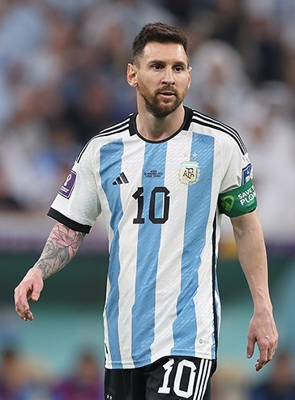
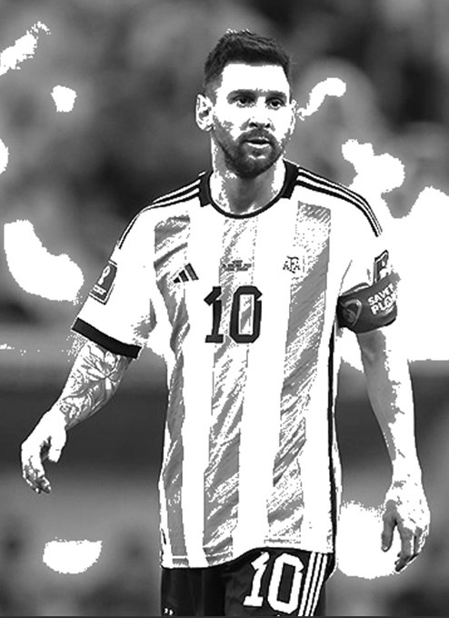

Slide 42
CONCLUSION

Slide 43
1. GUNA VARDHAN : Image tresholding (ppm) 2. MADHAVA NARAYANAN KJ : Pseudo code (logic) 3. NILAVARASAN M : image tresholding (bmp) 4. P SAI SANTHAN : main codes
INDIVIDUAL CONTRIBUTION:
.

Slide 44
THANK YOU
GROUP 12
.

